Slide 1
OSI data link layer
CCNA Exploration Semester 1
Chapter 7

Slide 2
OSI data link layer
OSI model layer 2
TCP/IP model part of Network Access layer
Application
HTTP, FTP, TFTP, SMTP etc
Presentation
Data stream
Application
Session
Transport
Segment
TCP, UDP
Transport
Network
Packet
IP
Internet
Data link
Frame
Ethernet, WAN technologies
Network Access
Physical
Bits

Slide 3
Data link layer topics
Data Link layer protocols
Preparing data for transmission
Media access control methods
Logical network topologies
Encapsulating packets into frames
Layer 2 frame structure and header and trailer fields

Slide 4
Functions of data link layer
Encapsulates packets by adding a frame header and trailer including appropriate addressing.
Controls access to the transmission medium.

Slide 5
Hops
There may be a different layer 2 protocol in use on each hop of a journey.
Different media, different types of link, different bandwidths, LAN/WAN affect the choice of protocol.
Different protocols have different frames.
The router removes the old frame and adds a new header and trailer for the next hop.

Slide 6
Sublayers
Sets up the frame header and trailer to encapsulate the packet.
Identifies network layer protocol.
Network
Logical link control
Data link
Adds layer 2 address.
Marks frame start and end.
Media access control
Physical

Slide 7
Standards
Institute of Electrical and Electronics Engineers
IEEE 802.2 Logical link control
IEEE 802.3 Ethernet
IEEE 802.5 Token ring
IEEE 802.11 Wi-fi
International Telecommunication Union (ITU)
Various WAN standards: HDLC, ISDN, Frame relay

Slide 8

Point to point link
Only two devices on the network
Full duplex: both can send at the same time, no problem with media access
Half duplex: data can only travel one way at a time so one device can send at a time. Simple media access control.

Slide 9
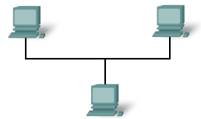
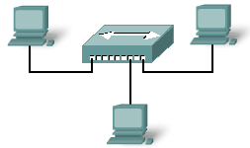
Shared medium
Physical bus
Star with hub
Needs media access control.
If there is no control there will be many collisions and the frames will be destroyed.

Slide 10
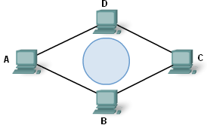
Controlled media access
Predictable, deterministic.
Each device is given a time when it may send, and it most not send at any other time.
High overhead.
No collisions.
Token passing – each host in turn gets the token and is allowed to send.
E.g. token ring, FDDI

Slide 11
Contention based media access
Non-deterministic, first come first served.
Each device “listens” and sends when the medium seems to be clear.
Low overhead.
Collisions occur.
Need a way of re-sending lost frames.
Becomes inefficient on large networks.
E.g. traditional Ethernet.

Slide 12
Variation on contention based
Traditional Ethernet uses CSMA/CD (collision detection): collisions are allowed and detected, frames sent again.
Wi-fi uses CSMA/CA (collision avoidance): when the medium is clear, host sends signal to say it is about to use the medium. It then sends.

Slide 13

Different environments
Fragile environment e.g. satellite link – frames are likely to be lost – need large overhead of control mechanisms to make sure data arrives.
Protected environment e.g. modern LAN – frames not often lost – do not need such elaborate control mechanisms
Therefore need different layer 2 protocols

Slide 14

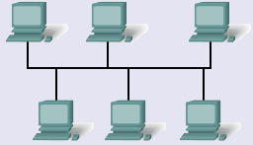
Addressing needs
Point to point link – only one possible destination. Minimal addressing.
Multi-access network – need full addressing system.
Therefore need different layer 2 protocols.

Slide 15

Layer 2 frame format
All protocols have the same general form but there are variations.

Slide 16

PPP frame
Point to point links. Minimal addressing. Control mechanisms.
Start
Minimal address
Check and stop
Packet

Slide 17

Ethernet frame
Multi-access links. Full addressing.
No control field.
Same for all Ethernet types/bandwidths.
Timing and start
Addresses
48 bits each
Layer 3 protocol
Check and stop
Packet

Slide 18
802.11 Wi-Fi
LAN wireless protocol
Fragile environment – lots of interference, risk of lost frames, contention.
Every transmission needs to be acknowledged.
No acknowledgement – re-send frame.
Lots of control mechanisms in frame.

Slide 19
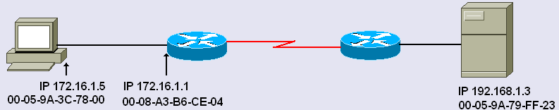
End to end
PC sends packet to server
Packet header has PC IP address and source and server IP address as destination.
Frame header has PC MAC address as source and router MAC address as destination.

Slide 20
The End

